Slide 1



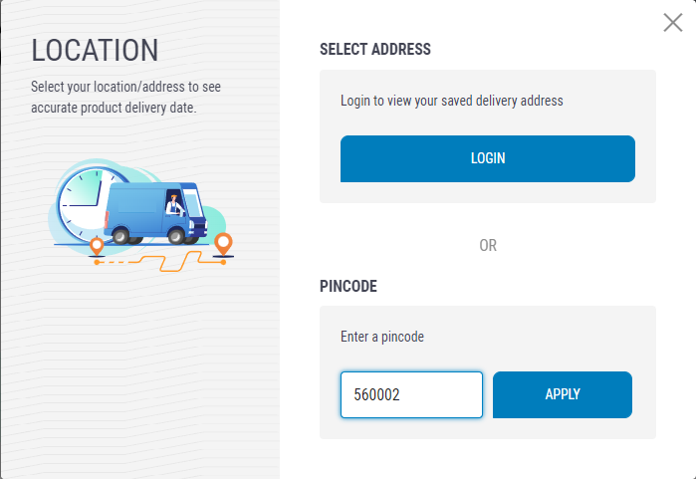
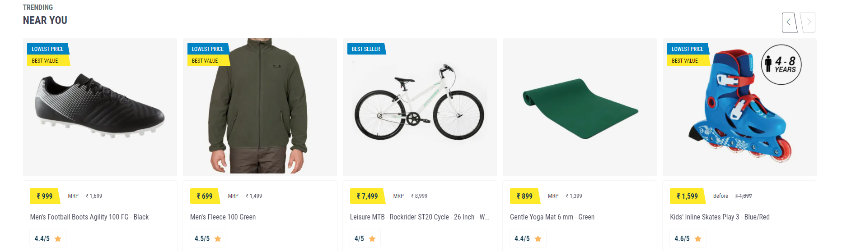
All
products
Lympus
kart
Search sports and accessory products
Delivery Location
601203 CHANGE
SIGN IN
603103

Slide 2

All
products
Lympus
kart
Search sports and accessory products
Delivery Location
601203 CHANGE
SIGN IN

Slide 3
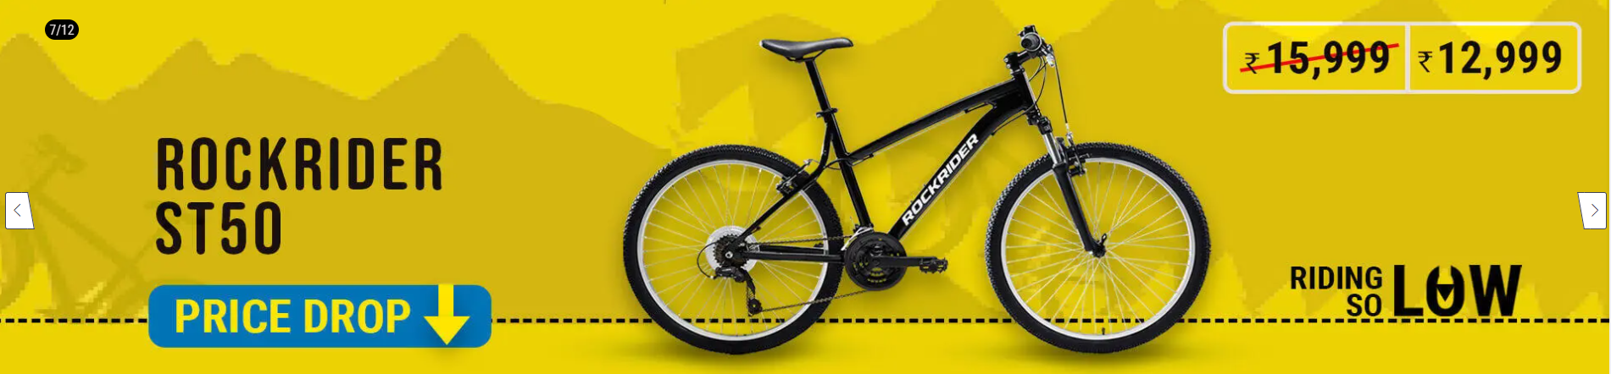

All
products
Lympus
kart
Search sports and accessory products
Delivery Location
601203 CHANGE
SIGN IN

Slide 4


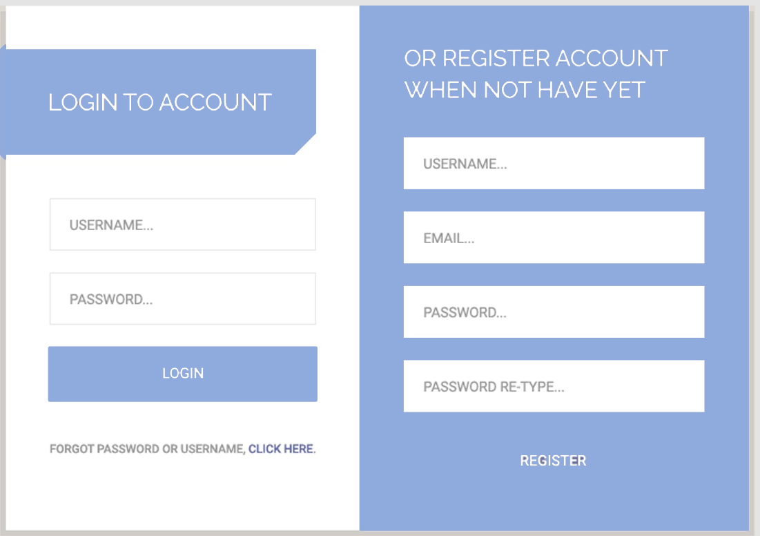
All
products
Lympus
kart
Search sports and accessory products
Delivery Location
601203 CHANGE
SIGN IN

Slide 5

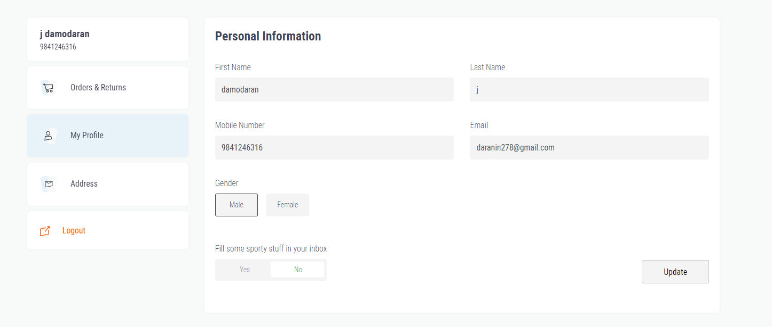
All
products
Lympus
kart
Search sports and accessory products
Delivery Location
601203 CHANGE
SIGN IN

Slide 6
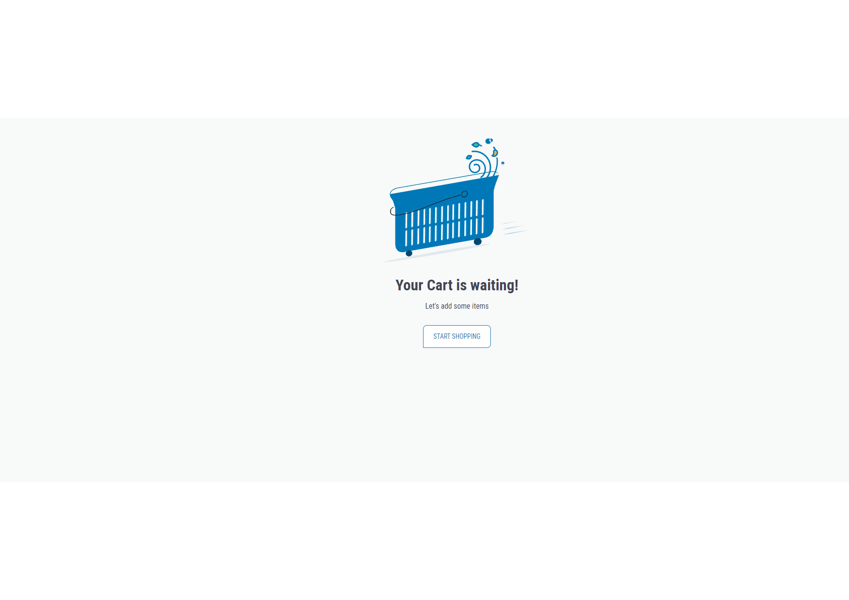
All
products
Lympus
kart
Search sports and accessory products
Delivery Location
601203 CHANGE
SIGN IN

Slide 7

All
products
Lympus
kart
Search sports and accessory products
Delivery Location
601203 CHANGE
SIGN IN

Slide 8
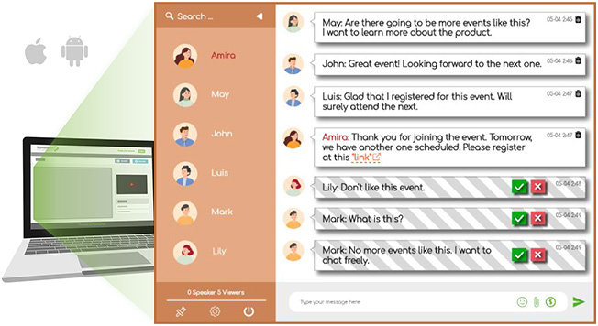
All
products
Lympus
kart
Search sports and accessory products
Delivery Location
601203 CHANGE
SIGN IN
Community chat box

